Slide 1

Car Rental System

Slide 2
Introduction
It is an online system through which customers can view available cars, register, view profile and book car.
The system helps the administration to maintain all details of the customer details, vehicle details, booking details and transaction details.
The car rental system is a reliable and efficient application that simplifies the process of renting a car. It provides a seamless experience for users and helps car rental companies manage their fleet of vehicles more efficiently.

Slide 3
Problem Statement
car rental is a vehicle Application that can be used temporarily for a fee during a specified period.
Getting a rental car helps people get around despite the fact they do not have access to their own personal vehicle or don’t own a vehicle at all.
The individual who needs a car must contact a rental car company and contract out for a vehicle.
This system increases customer retention and simplify vehicle and staff management.

Slide 4
Aim & Objectives
To produce a web based system that allow customer to register and reserve car online and for the owner to effectively manage their car rental business.
To ease customers task whenever they need to rent a car.

Slide 5
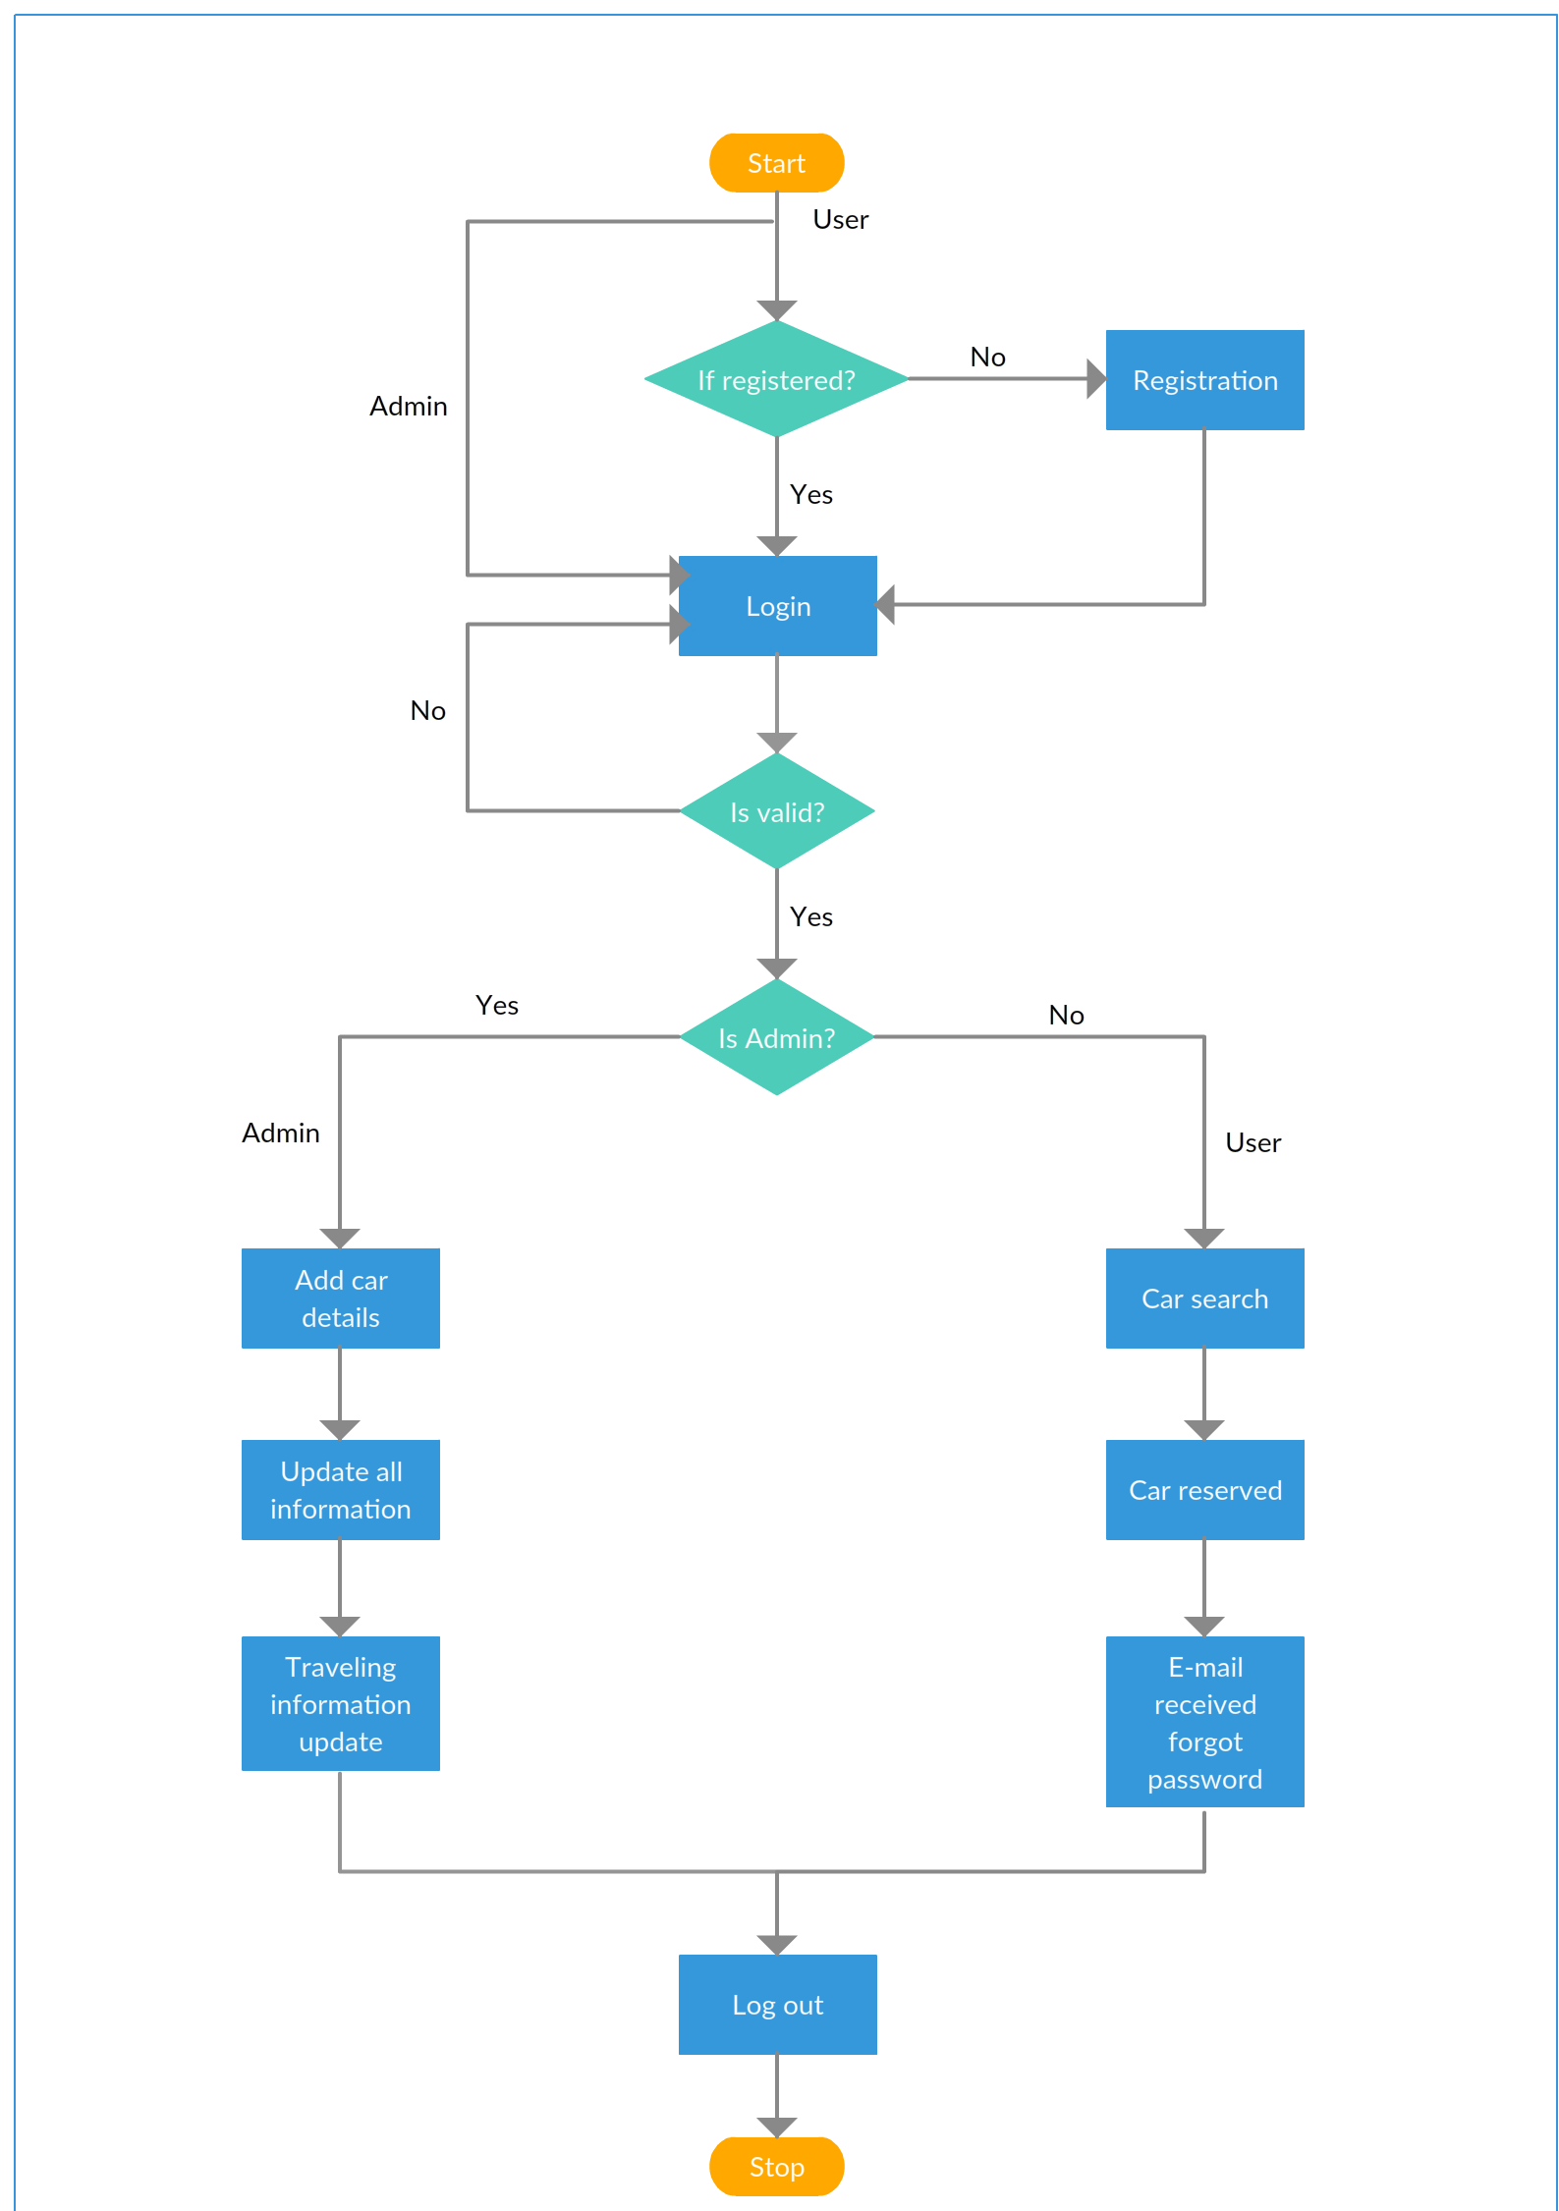
Architecture & Design

Slide 6
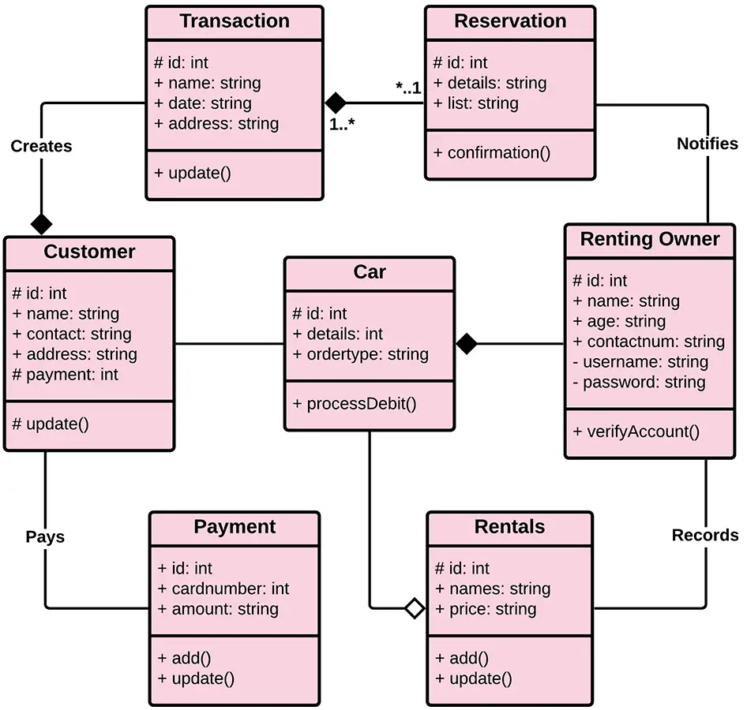
Database Class Diagram

Slide 7
System Components & Technology
In this project, we uses React as a front end technology & Spring Boot as a back end technology with MySQL database technology.
React is a declarative, efficient, and flexible JavaScript library for building user interfaces. It lets you compose complex UIs from small and isolated pieces of code called “components”.
Spring Boot contains all of the functionality of the standard Spring framework while also making application development much easier.

Slide 8
MySQL is ideal for storing application data, specifically web application data. MySQL is a relational database which stores data across multiple tables. As MySQL is a relational database, it's a good fit for applications that rely heavily on multi-row transactions.

